Slide 1
Welcome to ECE 457 Capstone Design
Paul Fortier
Professor ECE
Available Before Class Tues and Thurs
Available Anytime via email
pfortier@umassd.edu

Slide 2
Instructor Background
42 Years Industry Experience (Entrex, Nixdorf, NUWC, Purvis)
Research and Development
Systems Engineering
Line Management / Hiring
Professor at UMass Dartmouth– 26 years
Numerous ANSI, IEEE, IARIA, NASA, DoD and ASEE Committees
Technical Background
Systems Design / Computer Architecture
Digital Design (VLSI / FPGA)
Systems Software Research and Design (Real-time database systems, real-time operating systems)
Reliability analysis, Systems verification and validation testing
Sensor design

Slide 3
Administrative Information
Text
Design for Electrical and Computer Engineers: Theory, Concepts, and Practice, by Ralph M. Ford and Chris S. Coulston
Attendance
Ethics
Intellectual Property (IP)
IP Waivers will be discussed next week
Computer Literacy
Assumption is familiarity with Word, Powerpoint, and Excel
Content and Clarity are more important than style
Grading
Explained in syllabus and later slide
Accommodations

Slide 4
Course Objectives
Provides the experience of executing an engineering design project from start to finish.
Solving open-ended problems
Defining and assessing design options
Dealing with standards and constraints,
Introduction to the methodologies and soft skills required to plan and execute an engineering design project.
Working in teams
Planning and scheduling
Interaction with customers
Course is Highly Relevant When Interviewing for a Job and for Your Career Development

Slide 5
Course Grades
Most Important Positive Factors in Grading
How Well Your Project Meets Customer Requirements While Addressing Constraints
Your Understanding of the Problem Including Areas Where Requirements Were Not Met
Your Oral and Written Communication Skills
Negative Factors in Grading
Not Meeting Customer Requirements
Not Following a Reasonable Process
Not Working With Customer or Advisor as Often as Needed
Poor Quality Oral and Written Reports
IMPORTANT !! “Doing a Lot of Work” or “Building a Lot of Stuff” Doesn’t Matter if the Result Doesn’t Meet Your Customers Requirements

Slide 6
Overview Course and Design Process
ECE457- Engineering Design Process Overview
Requirements & Assumptions
Customer
Needs
Define Customer Needs in Engineering Terms
Requirements
Review
(Gate N)
Develop and
Assess Alternatives to Find
“Best Solution”
Concept
Design
Review
(Gate N+1)
Customer Meetings
“Best” => System meets requirements and addresses constraints in most effective way
Standards and Constraints
Team Leads Select
Team Members
Mini- Resumes
To ECE
458
Preliminary Design Review and
Preliminary Test
Plan Review
(Gate N+2)
Preliminary Design
Prototyping, Simulation
Modeling, and Analysis
Preliminary Test Plan
Team Lead
Project Selection
Team Lead Selection

Slide 7
Course Assignments Professional and Educational Perspective
Class Activity | Professional | Educational
System Requirements Review | Provides practice in the important process of translating non-technical requirements into technical ones | Requirements form the basis for evaluating your performance (grade!)
Concept Design Review | Generally required to either provide the customer with choices and/or demonstrate that “best” solutions have been identified Avoids the “Here’s the answer- what’s the problem” syndrome | Provides the opportunity to utilize learning from multiple courses; provides practice in not jumping to the first solution
Preliminary Design Review | Required to verify that the proposed design solution to problem meets requirements | Checkpoint on your progress; verifies that your proposed solution is practical in an academic environment

Slide 8
Course Structure
Project Team
Executes Project
Completes Assignments
Meets with Customer as needed and Faculty Advisor Bi-Weekly (minimum)
Course Coordinator
Design Process
Works with Teams, Customers, and Faculty Advisors to Resolve Problems
Grading
Faculty Advisor
Provides Technical Guidance and Pointers to Sources of Information
Meets with Team regularly
Customer/ Sponsor
Provides Requirements and Guidance
Provides Resources
Evaluates Quality of Project

Slide 9
Schedule- 1

Slide 10
Schedule- 2

Slide 11
Course Shared Drive
ECE457
Syllabus
General Information
Project Overviews
Students
Projects
Lectures
Assignments
Student and Project Folders are Read/ Write access as appropriate
All assignments will be submitted into Student or Project folders
Bold => Folders

Slide 12
Current Enrollment (COIN) Data as of 09/05/2019
First Name | Last Name |  | First Name | Last Name
Pascal Leocles | Alexis |  | Ryan John | McCarthy
Majed | Alharbi |  | Peter | McGrory
Jared | Alves |  | Aaron | Moore
Joao | Alves |  | John Charles | Morales
Michael | Benker |  | Jaykumar | Patel
Justin | Bickford |  | Michael | Pelosi
Tyler | Botelho |  | Kevin | Prairie
Jason | Brice |  | Dennis Moreira | Robelo
Vander Lopes | Brito |  | David | Skarbek
Lewis | Brum |  | Zachary | Taylor
Jonathon | Cronin |  | Cameron | Whittle
Lucio | De Pra |  | Ben | Wierman
Ryan | Dumont |  | Liv Grace | de Freitas
Trevor | Fink |  | Jacob | Aubertine
Jamir | Gilmore-Junior |  | Stephen | Felix
Eric | Keefer |  | Steven | Ferreira
Abigail Rachel | Keith |  | Ryan | Furtado
Kaley Dorothy | Lindsay |  | Sakiynah | Howard
Drew Aaron | Martins |  | Alec | Merolla
James Joseph | McCarthy |  | Tom | Morrissey
First Name | Last Name
Jay | Votta
Kevin | Teque

Slide 13
Project Selection and Team Formation
Review Projects and Complete Mini- Resumes-- Everyone!!
If you are interested in leading a project team indicate on the mini- resume If you have already spoken to other programs about projects indicate this on your mini- resume
On Tues Sept 10 mini- resumes will be reviewed to select team leads and begin the team formation process
On Thurs Sept 12 team formation process will continue
Thursday Evening- I will email everyone (students and project sponsors) with results of the project team formation process
Sept 12- Teams should begin working with your sponsor/ customer.
IMPORTANT- If multiple students are interested in a project we can award them that project whether or not a team lead has expressed interest in that project!
All projects should have at least two members.
Other than the above there is no fixed definition of “Team Size”

Slide 14
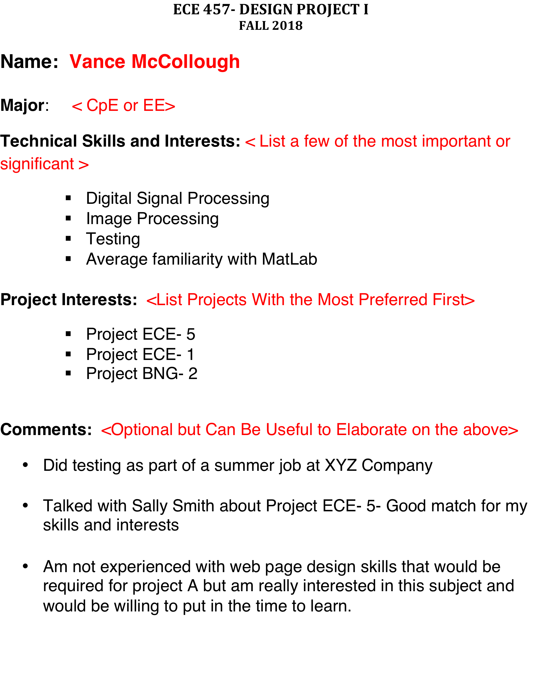
Mini- Resumes
Mini- Resumes
All Students, Including Team Leads must submit mini-resume
EMAIL TO ME AT EMAIL ADDRESS
pfortier@umass.edu
Responses due by 12:00 PM on Tues Sept 10th. Late Responses will not be considered
Uses
Team Lead
Team Member
Project Selection

Slide 15
Team Leads- Initial List
Team Leads Have Been Suggested by Faculty and Classmates
If You Do Not Wish to be a Team Lead, See Me After Class
If You Wish to Be a Team Lead But Are Not on This List Please Indicate on Mini-Resume
Being a Team Lead Can be a Positive Experience
Your Grade in the Course Will not be Affected Positively or Negatively Based on Your Status as Team Lead or Team Member
Majed | Alharbi
Jacob | Abertine
Abigail | Keith
James | McCarthy
Ryan | McCarthy
Peter | McGrory
Tom | Morrissey
Kevin | Prairie
Ben | Wierman
Team Lead Functions
Don’t have to be a technical “expert” on the project
Primary role is working with team to organize project and presentations
Typically schedule meetings with Sponsor and Advisor
My primary contact for project progress, problems, issues, etc.

Slide 16
Projects Project Descriptions are on m: drive in Project Descriptions Folder
Red: Faculty/ UMass Sponsored Project

Slide 17
Suggestions re Projects
Faculty or UMass- Sponsored ECE Projects
Project Numbers in Red
Potential Advantages
High Level of Access to Faculty/ UMass Sponsors
Projects in General are “State of the Art”
Benefit of above is opportunity to learn about new technologies with mentoring from faculty while executing your project
Externally Sponsored Projects
Project Numbers in Blue or Black
Blue => Sponsor access looks good
Black => Sponsor access less clear
Projects from Other Departments
MNE following different process than ECE and BNG
Slide is labeled “Suggestions” for a reason: Feel free to choose projects based on interests

Slide 18
Final Notes and Tips for Success
Note
Make sure you are enrolled and that your email is correct
Make sure you can access the m: drive ECE 457 Folder
Review Projects and Submit Mini-Resumes by Noon Tues Sept 10
Tips
Don’t get Behind Schedule!!! This is the Number 1 Cause of Problems
If You Encounter Problems You Can’t or Don’t Know How to Solve:
Raise them with your Customer, Faculty Advisor, or Coordinator ASAP
Problems Generally Don’t go Away- They Get Worse and Cost you Time
Keep ALL Data, Information, etc. in Your Design Notebook and/or on Your Computer. Retain Previous Versions- You May Need Them
Develop a System to Manage and Save Your Data, Code, Results, etc. on the Computer. Doesn’t Have to be Fancy.

